Slide 1
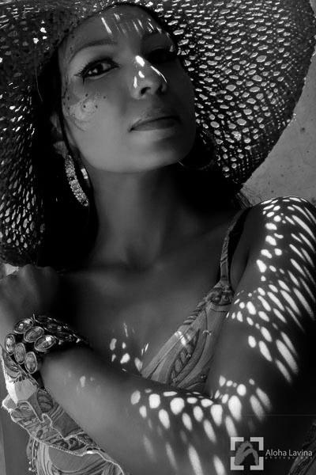
Shadow and Light Portraits
Studio Photography

Slide 2
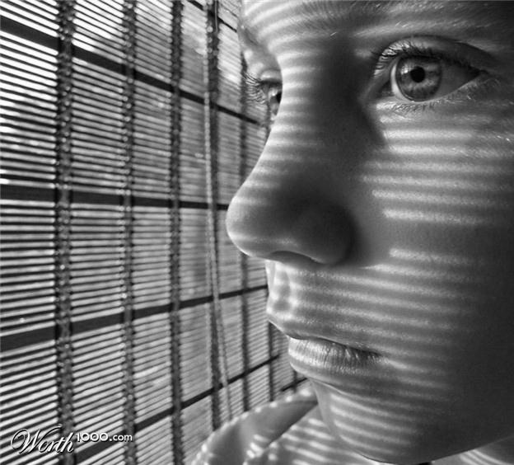
Shadows
What can you think of that you can shine light through to create shadows?

Slide 3
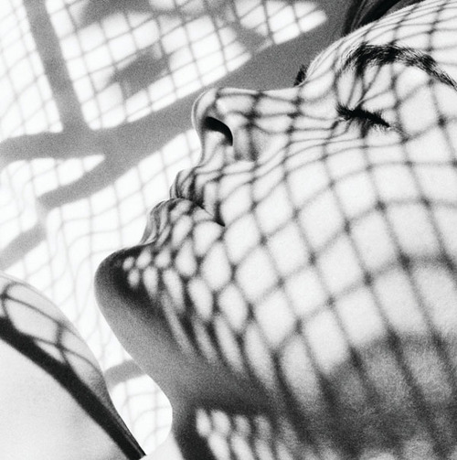
Maybe…
Screens
Lace
Crocheted Blanket
Poster Board with Cut outs
And more…

Slide 4
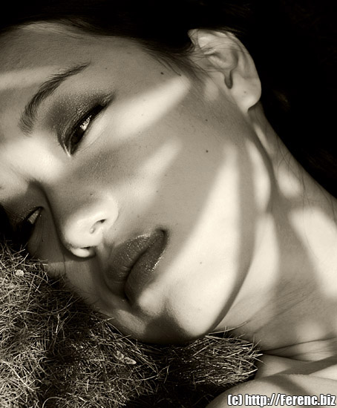
Contrast
You will be grade on the contrast you achieve between the highlights and shadows

Slide 5
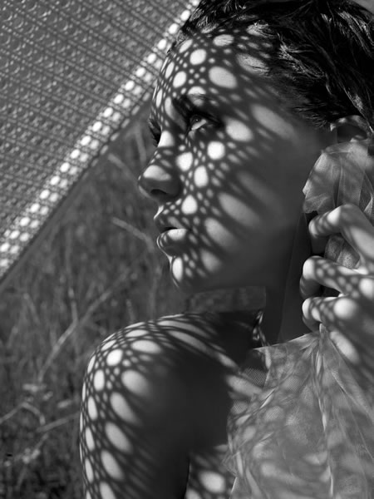
Project
You will take close up pictures of people using shadow effects
Inside or outside of school
24 exposures
ASA 400
Get close
Be aware of Background
ALL about the LIGHT and Shadows!

Slide 6
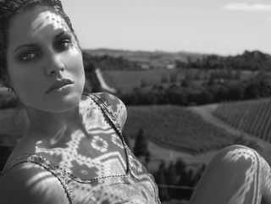
You will Turn in: 3- 8x10in. pictures

Slide 7
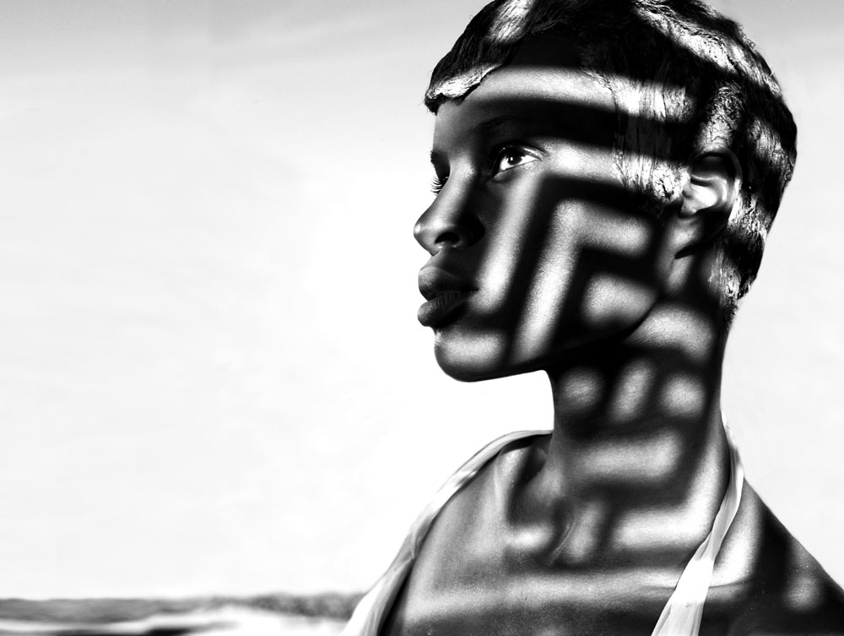

Slide 8
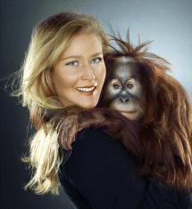
Jill Greenberg
Famous Portrait Photographer
http://www.youtube.com/watch?v=ryaDUjZ0Zj8
http://www.youtube.com/watch?v=IPg8WVxoezU&feature=related

Slide 9
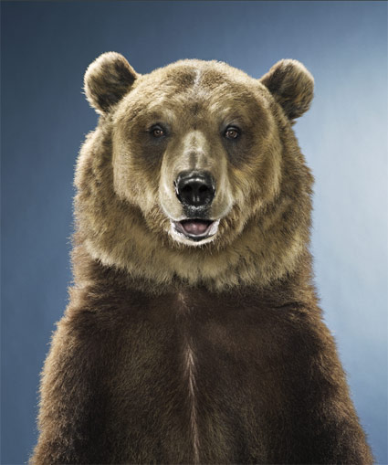
Digital Component
20-30 digital pictures
Lots of EMOTION
Props if you light
In Class with white or black background

Slide 10
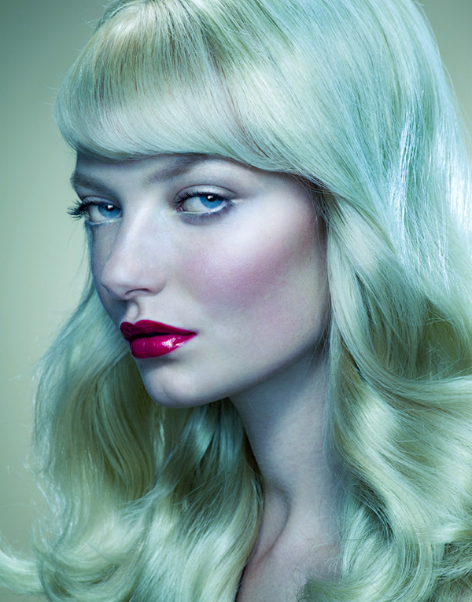
Creating Mood
Adding a color tint will change the mood of your pictures
This blue/green tine shows a cool soothing mood

Slide 11
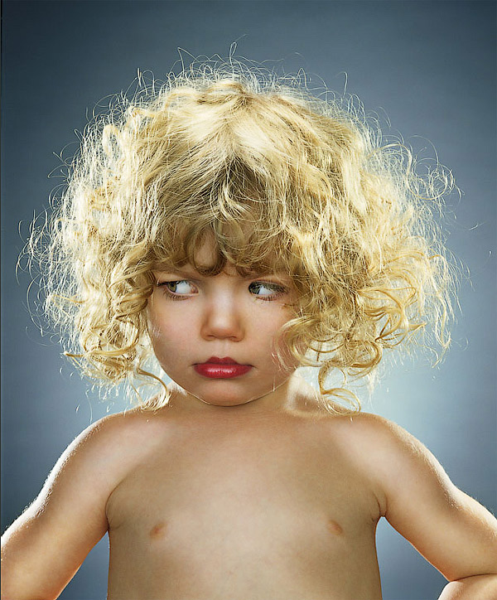
Photoshop
Follow steps of the tutorial to effect the lighting
3 shiny pictures
Mount them together

Slide 12
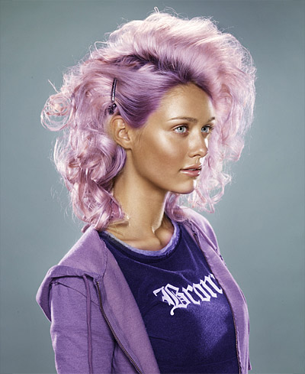

Slide 13
